Slide 1
Faculty Development Program (FDP) Day 2 - Curriculum Design & Lesson Planning with AI

Slide 2
Session 6: AI for Curriculum Redesign

Slide 3
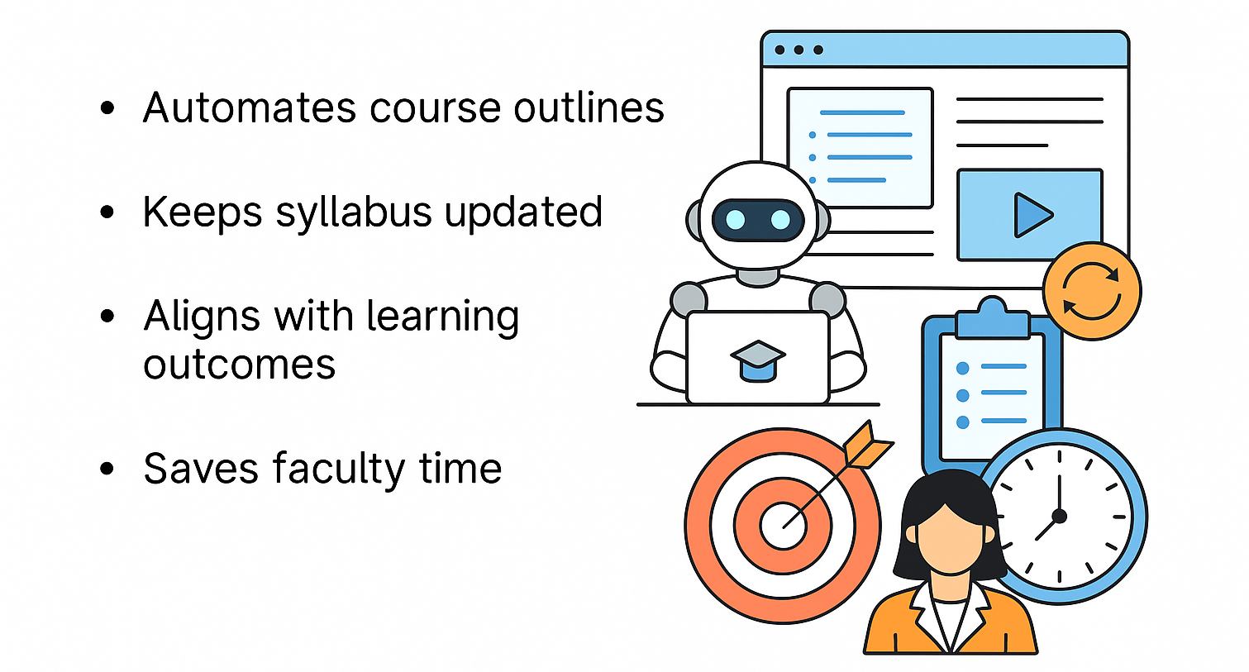
Role of AI in Modern Curriculum Design
AI helps in automating curriculum outlines and keeps them updated with the latest knowledge.
It ensures alignment with learning outcomes and reduces repetitive manual work for educators.

Slide 4
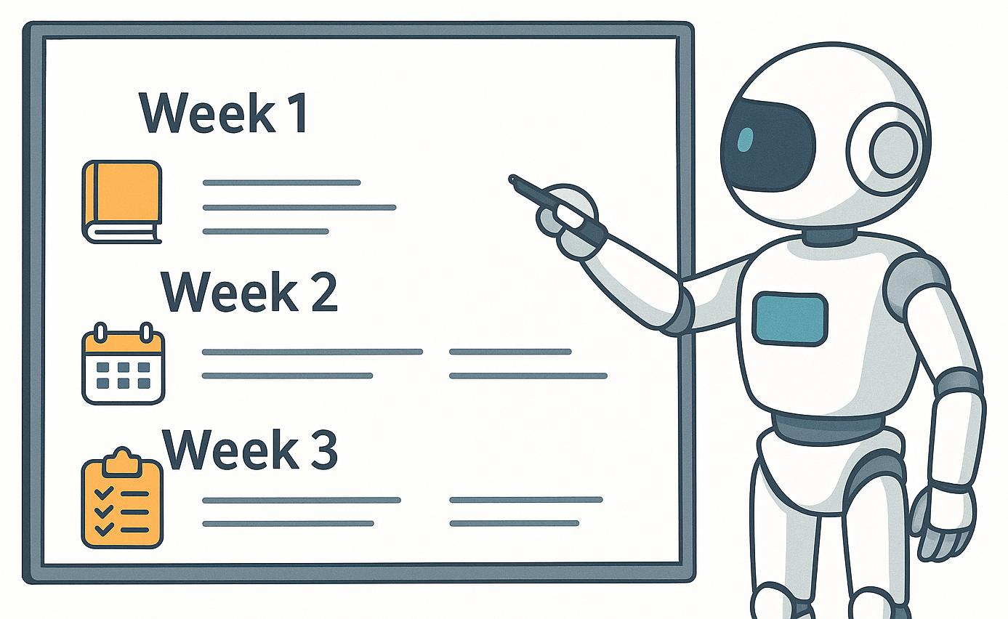
How AI Auto-Generates Syllabus
Breaks syllabus into weekly plans, Suggests quizzes & assignments
Balances theory and practice, Adapts to student learning pace, Reduces manual effort for teachers

Slide 5
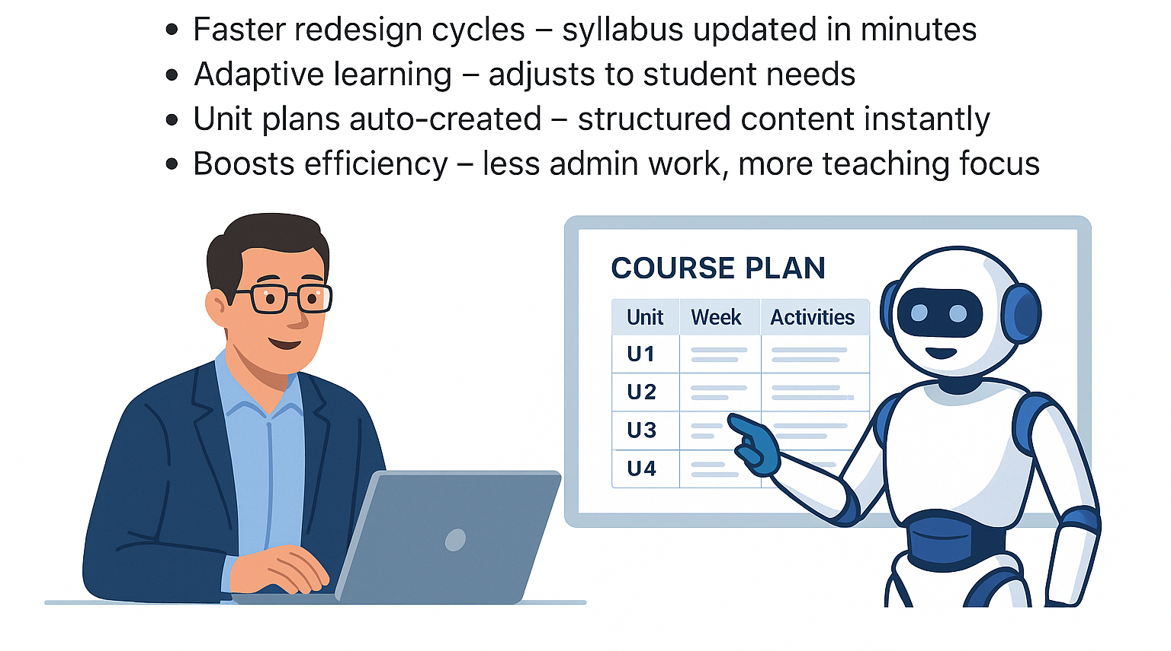
Case Study: AI-Powered Course Design
Updates syllabus in minutes, Adapts to student needs
Creates unit plans automatically, Reduces admin work → more teaching focus

Slide 6
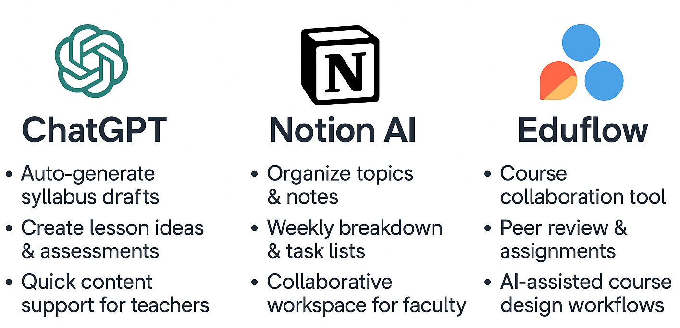
Tools: ChatGPT, Notion AI, Eduflow

Slide 7


Slide 8



Slide 9
Session 6: Quiz
Q.1 Which AI tool helps in organizing topics and weekly breakdowns? a) Canva AI b) Notion AI c) DALL·E d) Kahoot
Answer: b) Notion AI

Slide 10
Session 6: Quiz
Q.2 AI can automatically generate syllabus structures and weekly plans. (True/False)
Answer: True

Slide 11
Session 6: Quiz
Q.3 Which of the following is an example of AI-powered curriculum redesign? a) Manually writing syllabus in Word b) Using ChatGPT to generate syllabus draft c) Printing old syllabus copies d) Copying another institute’s syllabus
Answer: b) Using ChatGPT to generate syllabus draft

Slide 12
Session 6: Quiz
Q.4 Which tool is mainly used for collaborative course workflows? a) Eduflow b) ChatGPT c) Kahoot d) Canva
Answer: a) Eduflow

Slide 13
Session 6: Quiz
Q.5 AI-powered curriculum design completely removes the need for human educators. (True/False)
Answer: False

Slide 14
Session 7: Personalized GPTs for Outcome-Based Education (OBE)

Slide 15
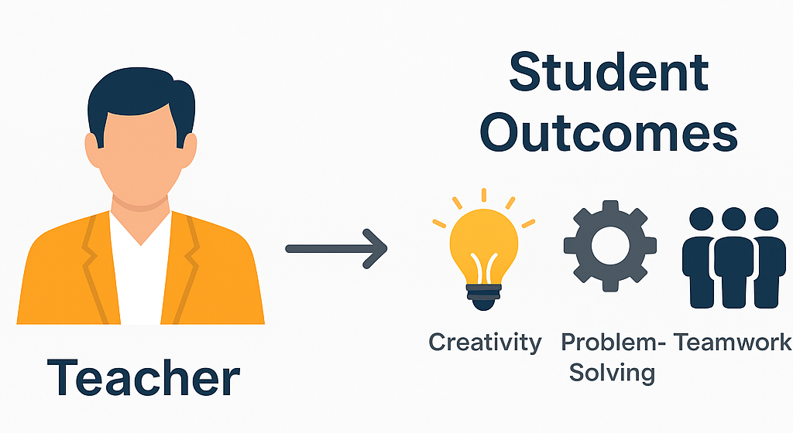
Introduction to OBE Principles
OBE = Outcome-Based Education, focus on results, not just teaching.
Defines clear learning outcomes for each course/unit.
Builds real-world skills like problem-solving & teamwork.

Slide 16
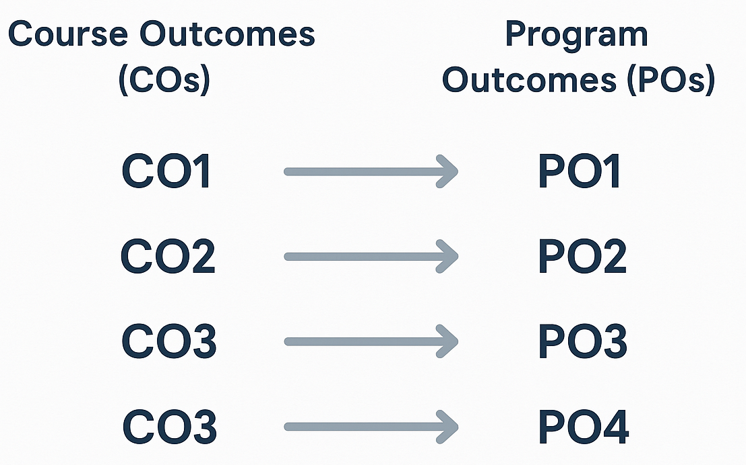
CO-PO mapping explained
Course Outcomes (COs): Goals achieved in a specific subject/unit.
Program Outcomes (POs): Broad skills gained at program level.
Mapping CO - PO ensures subjects contribute to overall program vision.
AI/GPT makes mapping faster, accurate & consistent.

Slide 17
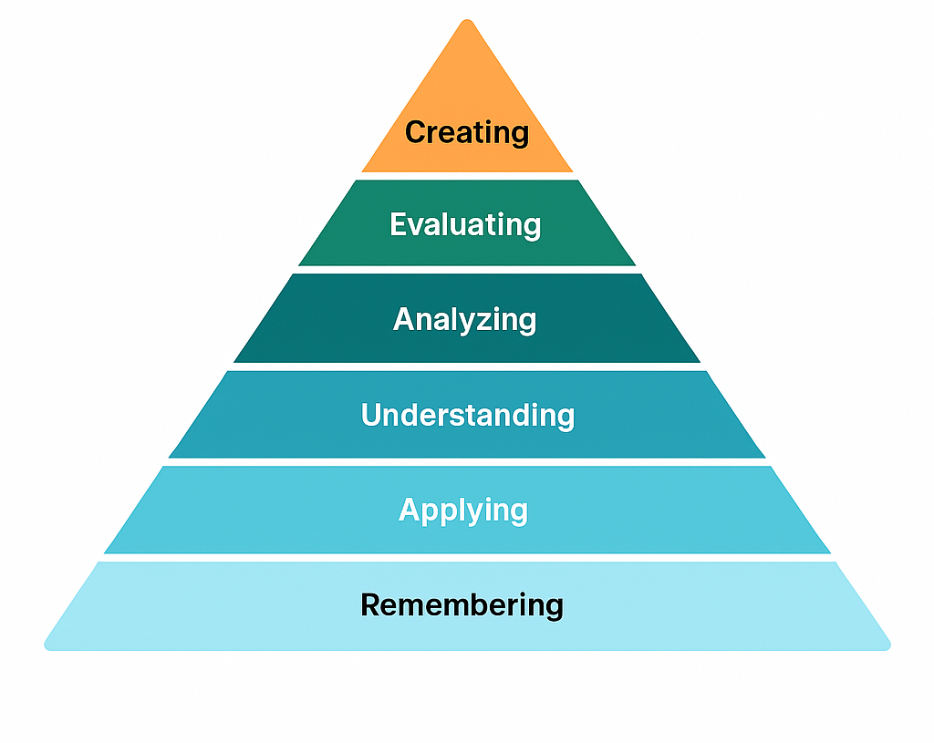
Bloom’s Taxonomy Levels for Education
Remembering - Recall facts, definitions, and basic concepts
Applying - Use knowledge in real-world situations
Understanding - Explain ideas in own words, interpret meaning
Analyzing - Break information into parts, find relationships
Evaluating - Judge based on criteria, justify decisions
Creating - Develop new ideas, solutions, or projects

Slide 18
Using GPT for automated alignment of COs and POs
GPT can auto-generate CO-PO tables in seconds. It ensures clarity and consistency across subjects. Faculty save time on manual mapping and can focus on curriculum design. Mapping helps ensure each Course Outcome (CO) contributes to broader Program Outcomes (POs).
Course Outcomes (COs) | PO1: Knowledge | PO2: Problem Solving | PO3: Application | PO4: Innovation
CO1 – Basic Concepts | ✅ |  | ✅
CO2 – Problem Solving Skills | ✅ | ✅
CO3 – Practical Applications |  | ✅ | ✅
CO4 – Creativity & Design |  |  | ✅ | ✅

Slide 21
Session 7: Quiz
Q.1 What is the main benefit of using GPT for CO-PO mapping? a) Manual effort increases b) Consistent and faster alignment c) Removes need for outcomes d) Random mapping
Answer: b) Consistent and faster alignment

Slide 22
Session 7: Quiz
Q.2 GPT can automatically generate CO-PO tables in seconds. (True/False)
Answer: True

Slide 23
Session 7: Quiz
Q.3 In CO-PO mapping, CO refers to: a) Course Objectives b) Course Outcomes c) Core Operations d) College Output
Answer: b) Course Outcomes

Slide 24
Session 7: Quiz
Q.4 Which Program Outcome (PO) usually refers to applying knowledge in real-world situations? a) PO1 – Knowledge b) PO2 – Problem Solving c) PO3 – Application d) PO4 – Innovation
Answer: c) PO3 - Application

Slide 25
Session 7: Quiz
Q.5 GPT ensures uniformity across courses when mapping COs to POs. (True/False)
Answer: True

Slide 26
Session 8: Lesson Planning with GPT

Slide 27
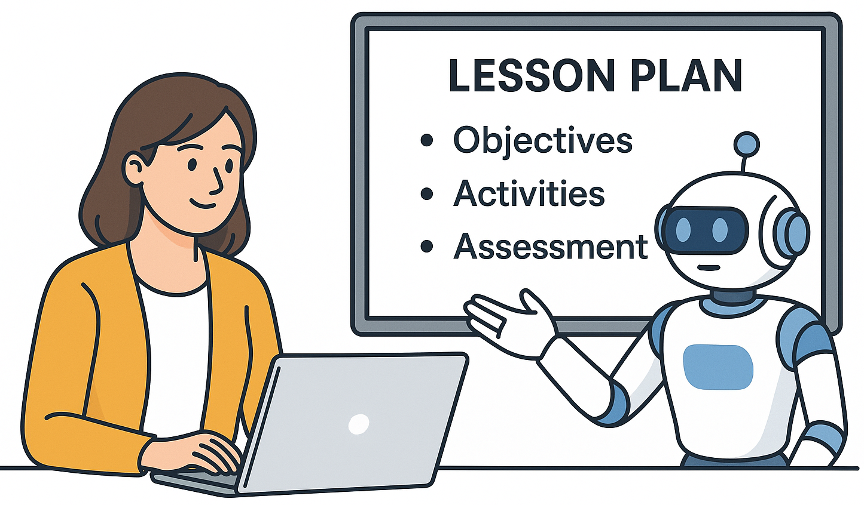
AI for lesson sequencing and activity creation
Structures syllabus flow - Arranges topics in correct order
Suggests classroom activities - Group tasks, case studies, discussions
Creates interactive learning flow - Smooth transition between lessons
Adapts to time limits - Fits into daily, weekly, or monthly plans
Saves preparation time - Automates routine planning work

Slide 28
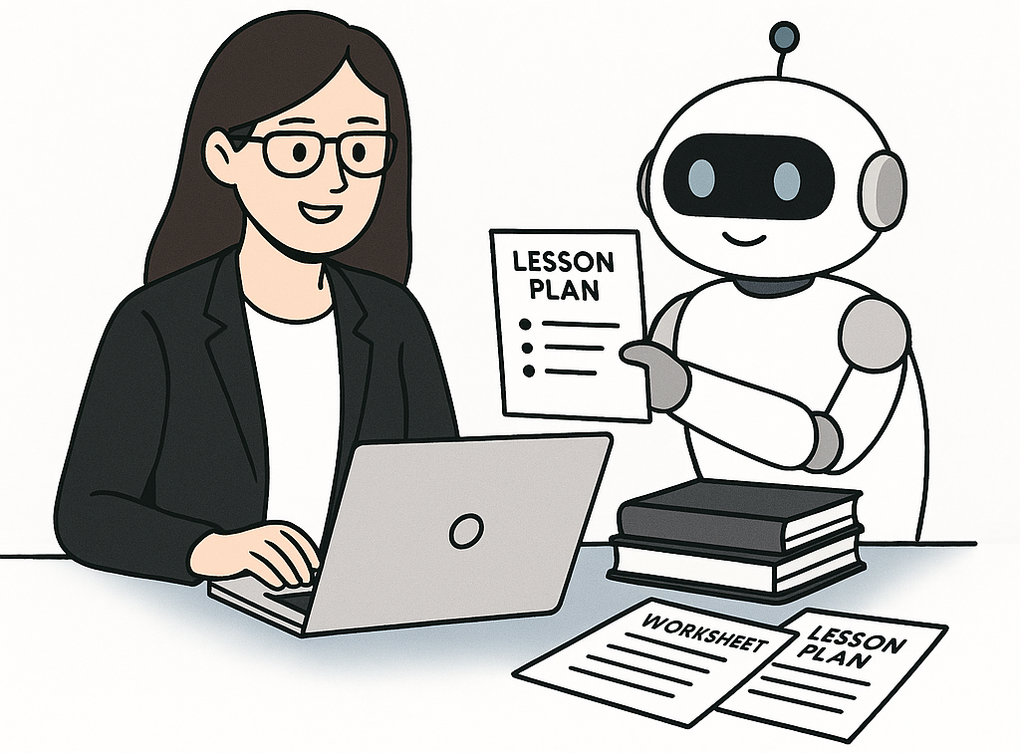
Benefits of GPT in preparing teaching resources
Quick Generation - Objectives, activities & assessments ready in minutes
Multiple Variations - Creates different lesson plan options
Adapts to Teaching Styles - Formal, interactive, or student-friendly
Saves Time - Reduces manual effort in content design
Engaging Material - Generates student-centered explanations & examples

Slide 31
Session 8: Quiz
Q.1 GPT can help teachers create lesson plans that include: a) Objectives, Activities, Assessments b) Games only c) Only assignments d) None of the above
Answer: a) Objectives, Activities, Assessments

Slide 32
Session 8: Quiz
Q.2 AI can automatically suggest the correct sequence of topics for a lesson. (True/False)
Answer: True

Slide 33
Session 8: Quiz
Q.3 Which of the following is a benefit of GPT in preparing teaching resources? a) Increases manual work b) Provides multiple lesson variations c) Creates confusion in content d) Replaces teachers completely
Answer: b) Provides multiple lesson variations

Slide 34
Session 8: Quiz
Q.4 Lesson sequencing refers to: a) Randomly mixing topics b) Arranging topics in logical order c) Ignoring student needs d) Writing only assignments
Answer: b) Arranging topics in logical order

Slide 35
Session 8: Quiz
Q.5 GPT-generated teaching resources can be adapted to: a) Only formal teaching b) Different teaching styles c) Only technical subjects d) Only online classes
Answer: b) Different teaching styles

Slide 36
Session 9: Group Task: Design a GPT-Powered Unit

Slide 37
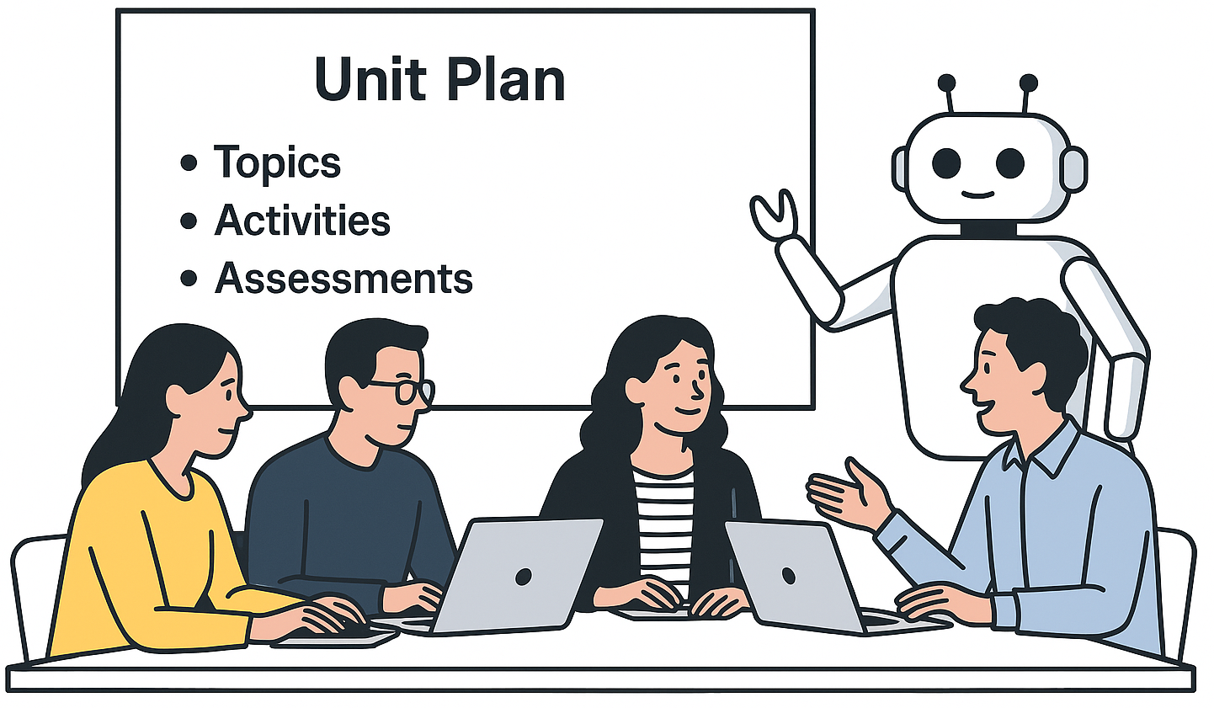
Apply AI in Full Unit Design
AI helps in unit design by creating the outline with topics and milestones, mapping CO-PO & Bloom’s levels, arranging proper lesson sequencing, drafting content and activities, and preparing assessments with rubrics. It ensures efficient planning and supports personalized learning for students.

Slide 38
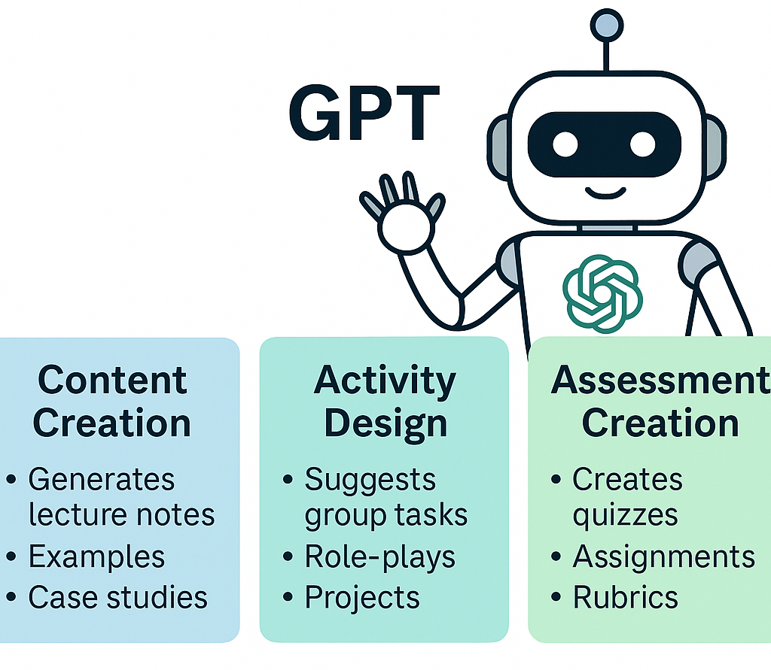
Using GPT for detailed content, activities, and assessment creation
Content: Generates notes, case studies, real-world examples
Activities: Designs group tasks, role-plays, projects
Assessments: Creates quizzes, assignments, rubrics
Customization: Adapts difficulty & style for learners
Efficiency: Saves time and ensures consistency

Slide 39

Collaboration and workflow sharing
A Custom GPT works best when the instructions are crystal clear.
Think of it like teaching a new assistant, the more specific you are, the better it performs.

Slide 42
Session 9: Quiz
Q.1 Which GPT feature helps in generating lecture notes and case studies? a) Activity Bank b) Content Creation c) Rubric Generator d) Collaboration Tool
Answer: b

Slide 43
Session 9: Quiz
Q.2 How does GPT support activity design? a) By grading assignments b) By suggesting group tasks & projects c) By tracking student attendance d) By scheduling deadlines
Answer: b

Slide 44
Session 9: Quiz
Q.3 In assessment creation, GPT can help generate: a) Rubrics and quizzes b) Library resources c) Timetables d) Internet browsing
Answer: a

Slide 45
Session 9: Quiz
Q.4 Collaboration with GPT allows faculty to: a) Work in isolation b) Share drafts & tasks in real time c) Remove peer inputs d) Avoid standardization
Answer: b

Slide 46
Session 9: Quiz
Q.5 What is the biggest benefit of using GPT in unit design? a) Manual workload increases b) Inconsistency in materials c) Saves time and ensures efficiency d) Restricts collaboration
Answer: c

Slide 47
Session 10: Showcase & Feedback

Slide 48
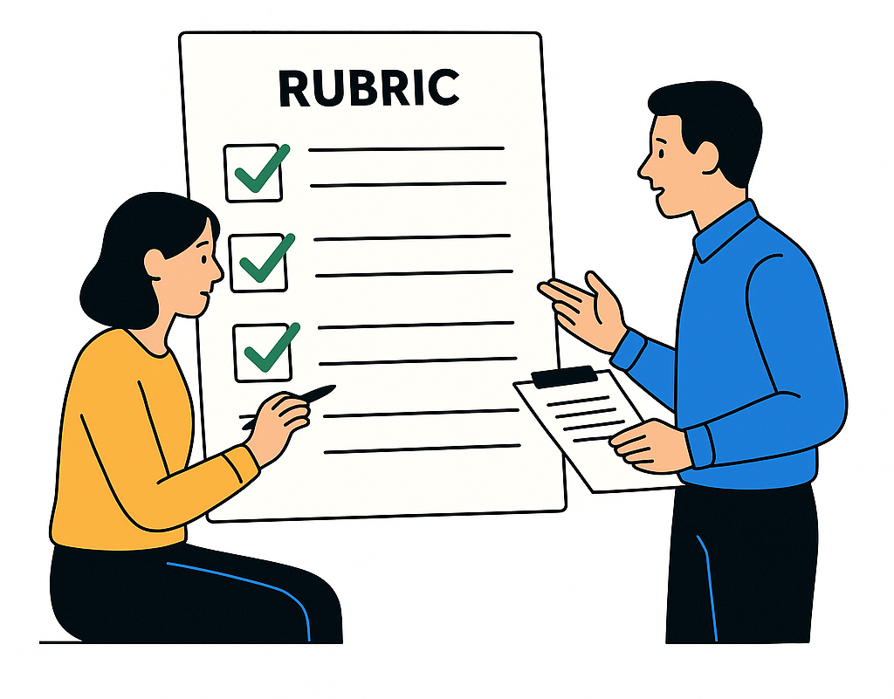
Peer-to-Peer review of designed units using feedback rubrics
Peer review promotes collaborative improvement
Helps identify strengths & gaps in unit design
Builds reflective and critical teaching skills
Rubrics ensure fairness and consistency

Slide 49
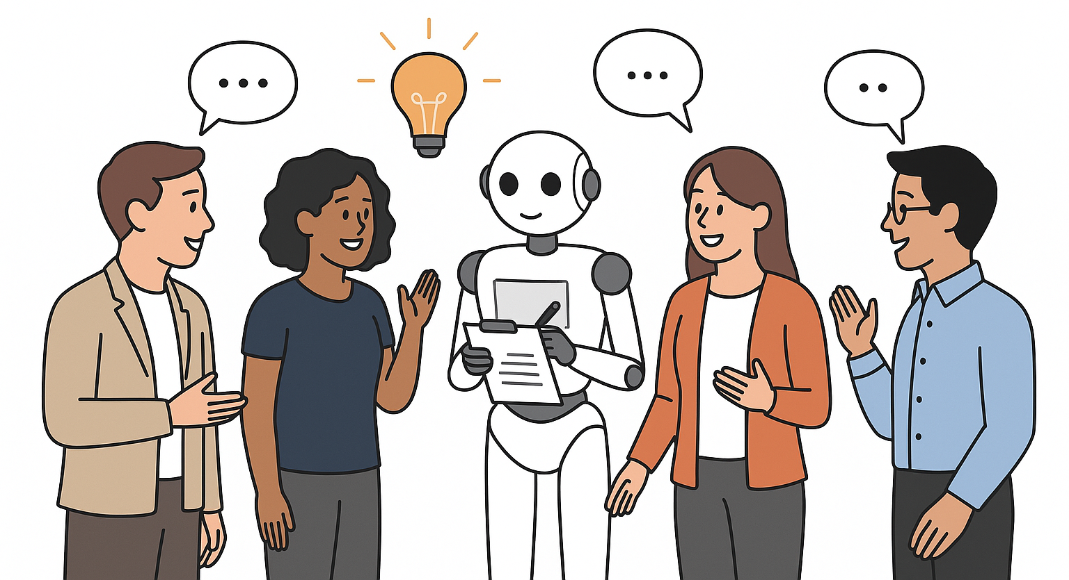
Sharing ideas and best practices
Exchange of innovative teaching ideas
Learn from real classroom practices
Build collective wisdom through sharing
Foster collaboration for better outcomes

Slide 50
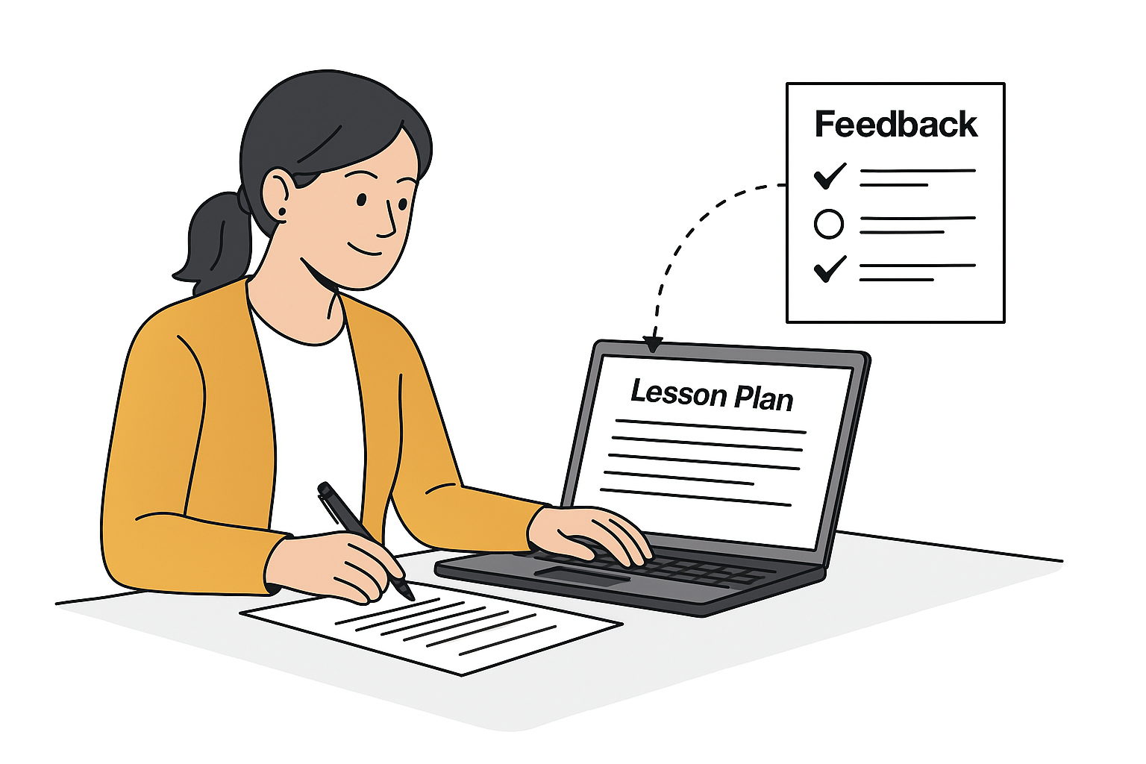
Refining outputs based on feedback
Refining outputs based on feedback
Improve clarity, structure, and relevance
AI suggests quick edits and enhancements
Feedback loop builds continuous improvement

Slide 53
Session 10: Quiz
Q.1 Peer-to-peer review in education mainly helps in: a) Competition among teachers b) Collaborative improvement of teaching units c) Avoiding teamwork d) Reducing communication
Answer: b

Slide 54
Session 10: Quiz
Q.2 What is the role of feedback rubrics in peer review? a) Provide random comments b) Ensure fairness and consistency in evaluation c) Replace all human judgment d) Eliminate collaboration
Answer: b

Slide 55
Session 10: Quiz
Q.3 Sharing best practices among faculty leads to: a) Isolation of ideas b) Collective improvement and cross-learning c) Reduced innovation d) Avoiding collaboration
Answer: b

Slide 56
Session 10: Quiz
Q.4 Refining outputs based on feedback ensures: a) No changes to teaching material b) Continuous improvement and quality enhancement c) Random updates without structure d) Avoidance of peer involvement
Answer: b

Slide 57
Session 10: Quiz
Q.5 Which of the following best describes the Showcase & Feedback session? a) Teachers present units and refine them with peer input b) Students compete for marks c) Only AI generates the final unit d) Feedback is ignored
Answer: a

